Slide 1
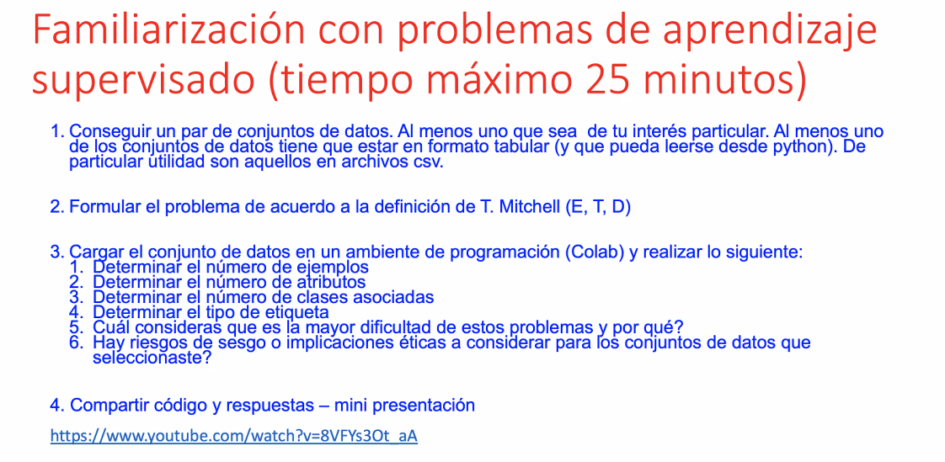

Slide 2
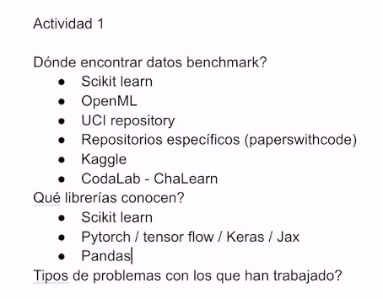

Slide 3
Regresion-basico-1.ipynb - Colaboratory (google.com)
Clasificación-intro-1.ipynb - Colaboratory (google.com)

Slide 4
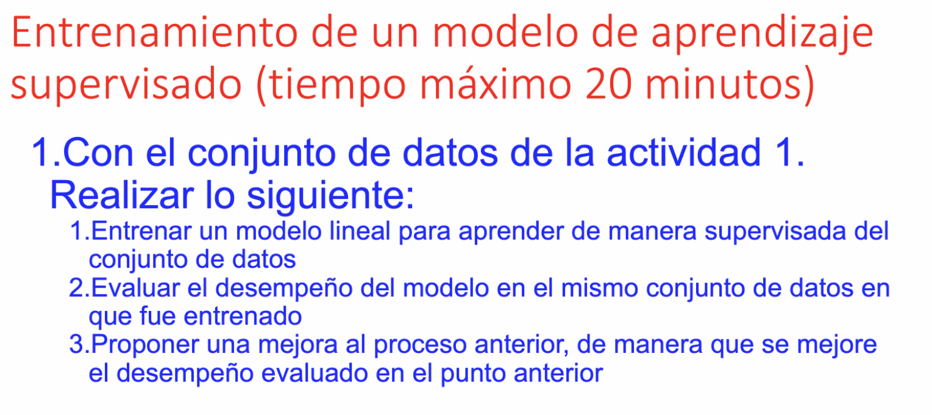

Slide 5
https://colab.research.google.com/drive/1lYFDSE-e-qCg1uHAz1wgGupV0p2UT7IF?usp=sharing

Slide 6
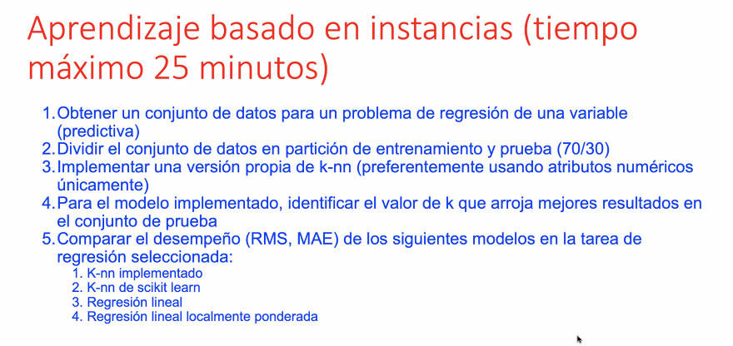

Slide 7
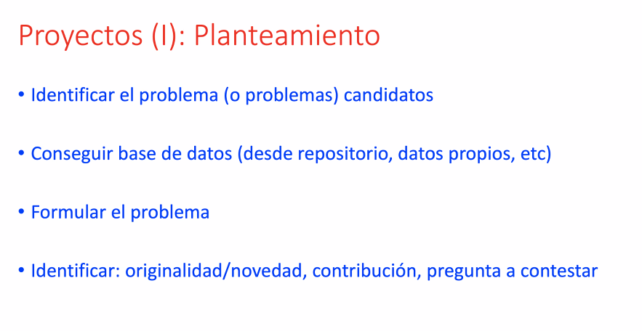

Slide 8
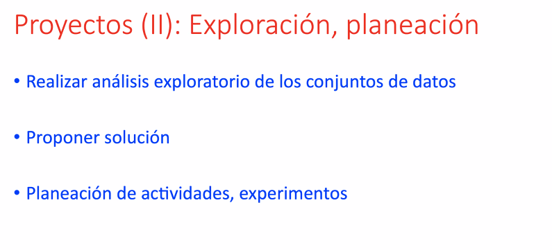

Slide 9
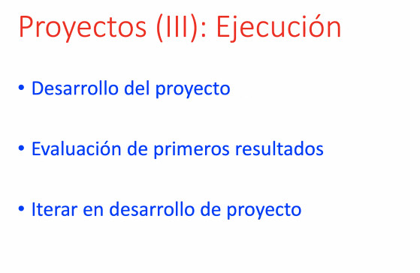

Slide 10
